Slide 1
Control Engineering
Lecture 9

Slide 2
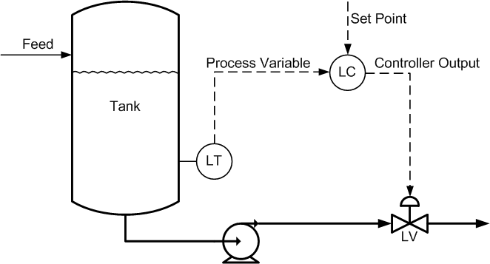
Cascade control
In single-loop control, the controller’s set point is set by an operator, and its output drives a final control element.

Slide 3
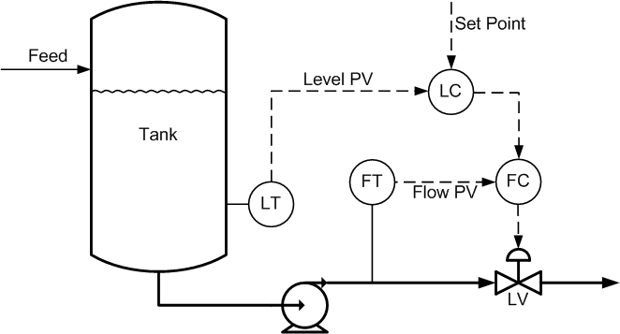
Cascade control
In a cascade control arrangement, there are two (or more) controllers of which one controller’s output drives the set point of another controller.

Slide 4
Cascade control
When Should Cascade Control be Used?
Cascade control should always be used if you have a process with relatively slow dynamics (like level, temperature, composition, humidity) and a liquid or gas flow, or some other relatively-fast process, has to be manipulated to control the slow process. For example: changing cooling water flow rate to control condenser pressure (vacuum), or changing steam flow rate to control heat exchanger outlet temperature. In both cases, flow control loops should be used as inner loops in cascade arrangements.

Slide 5
Cascade control
Does Cascade Control Have any Disadvantages?
Cascade control has three disadvantages.
  One, it requires an additional measurement (usually flow rate) to work.
  Two, there is an additional controller that has to be tuned.
  And three, the control strategy is more complex – for engineers and operators alike.
  These disadvantages have to be weighed up against the benefits of the expected improvement in control to decide if cascade control should be implemented.

Slide 6
Cascade control
When Should Cascade Control Not be Used?
Cascade control is beneficial only if the dynamics of the inner loop are fast compared to those of the outer loop. Cascade control should generally not be used if the inner loop is not at least three times faster than the outer loop, because the improved performance may not justify the added complexity.
In addition to the diminished benefits of cascade control when the inner loop is not significantly faster than the outer loop, there is also a risk of interaction between the two loops that could result in instability – especially if the inner loop is tuned very aggressively.

Slide 7
Cascade control
How Should Cascade Controls be Tuned?
A cascade arrangement should be tuned starting with the innermost loop. Once that one is tuned, it is placed in cascade control, or external set point mode, and then the loop driving its set point is tuned.

Slide 8
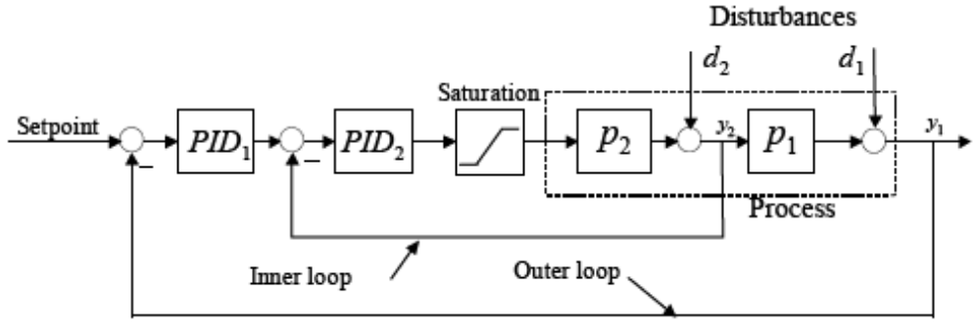
Cascade control
The block diagram

Slide 9
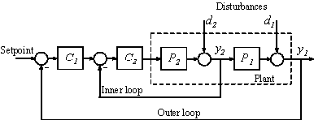

Example
C1 a PI controller with Kp = 0.015, Ti = 0.716
C2 a PID controller with Kp = 0.244, Ti = 0.134

Slide 10
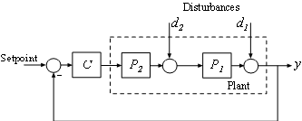
Example
Comparing the results with a single loop control system:
with C a PI controller: Kp = 0.0119, Ti = 0.849

Slide 11
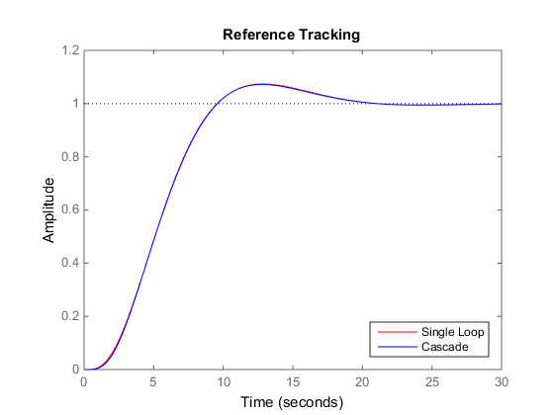
Example

Slide 12
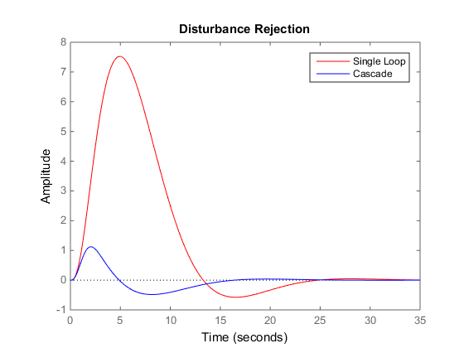
Example

